Slide 1
Python Flask: What is it and How to use it
FELIPE ALCÁZAR GÓMEZ
ENRIQUE SÁNCHEZ-MIGALLÓN OCHOA

Slide 2
Index
What is python Flask
Uses of Python Flask
Example: First Program

Slide 3
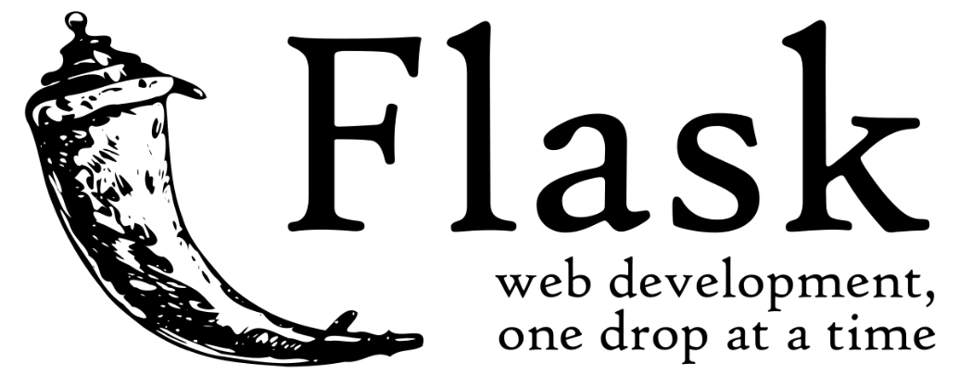
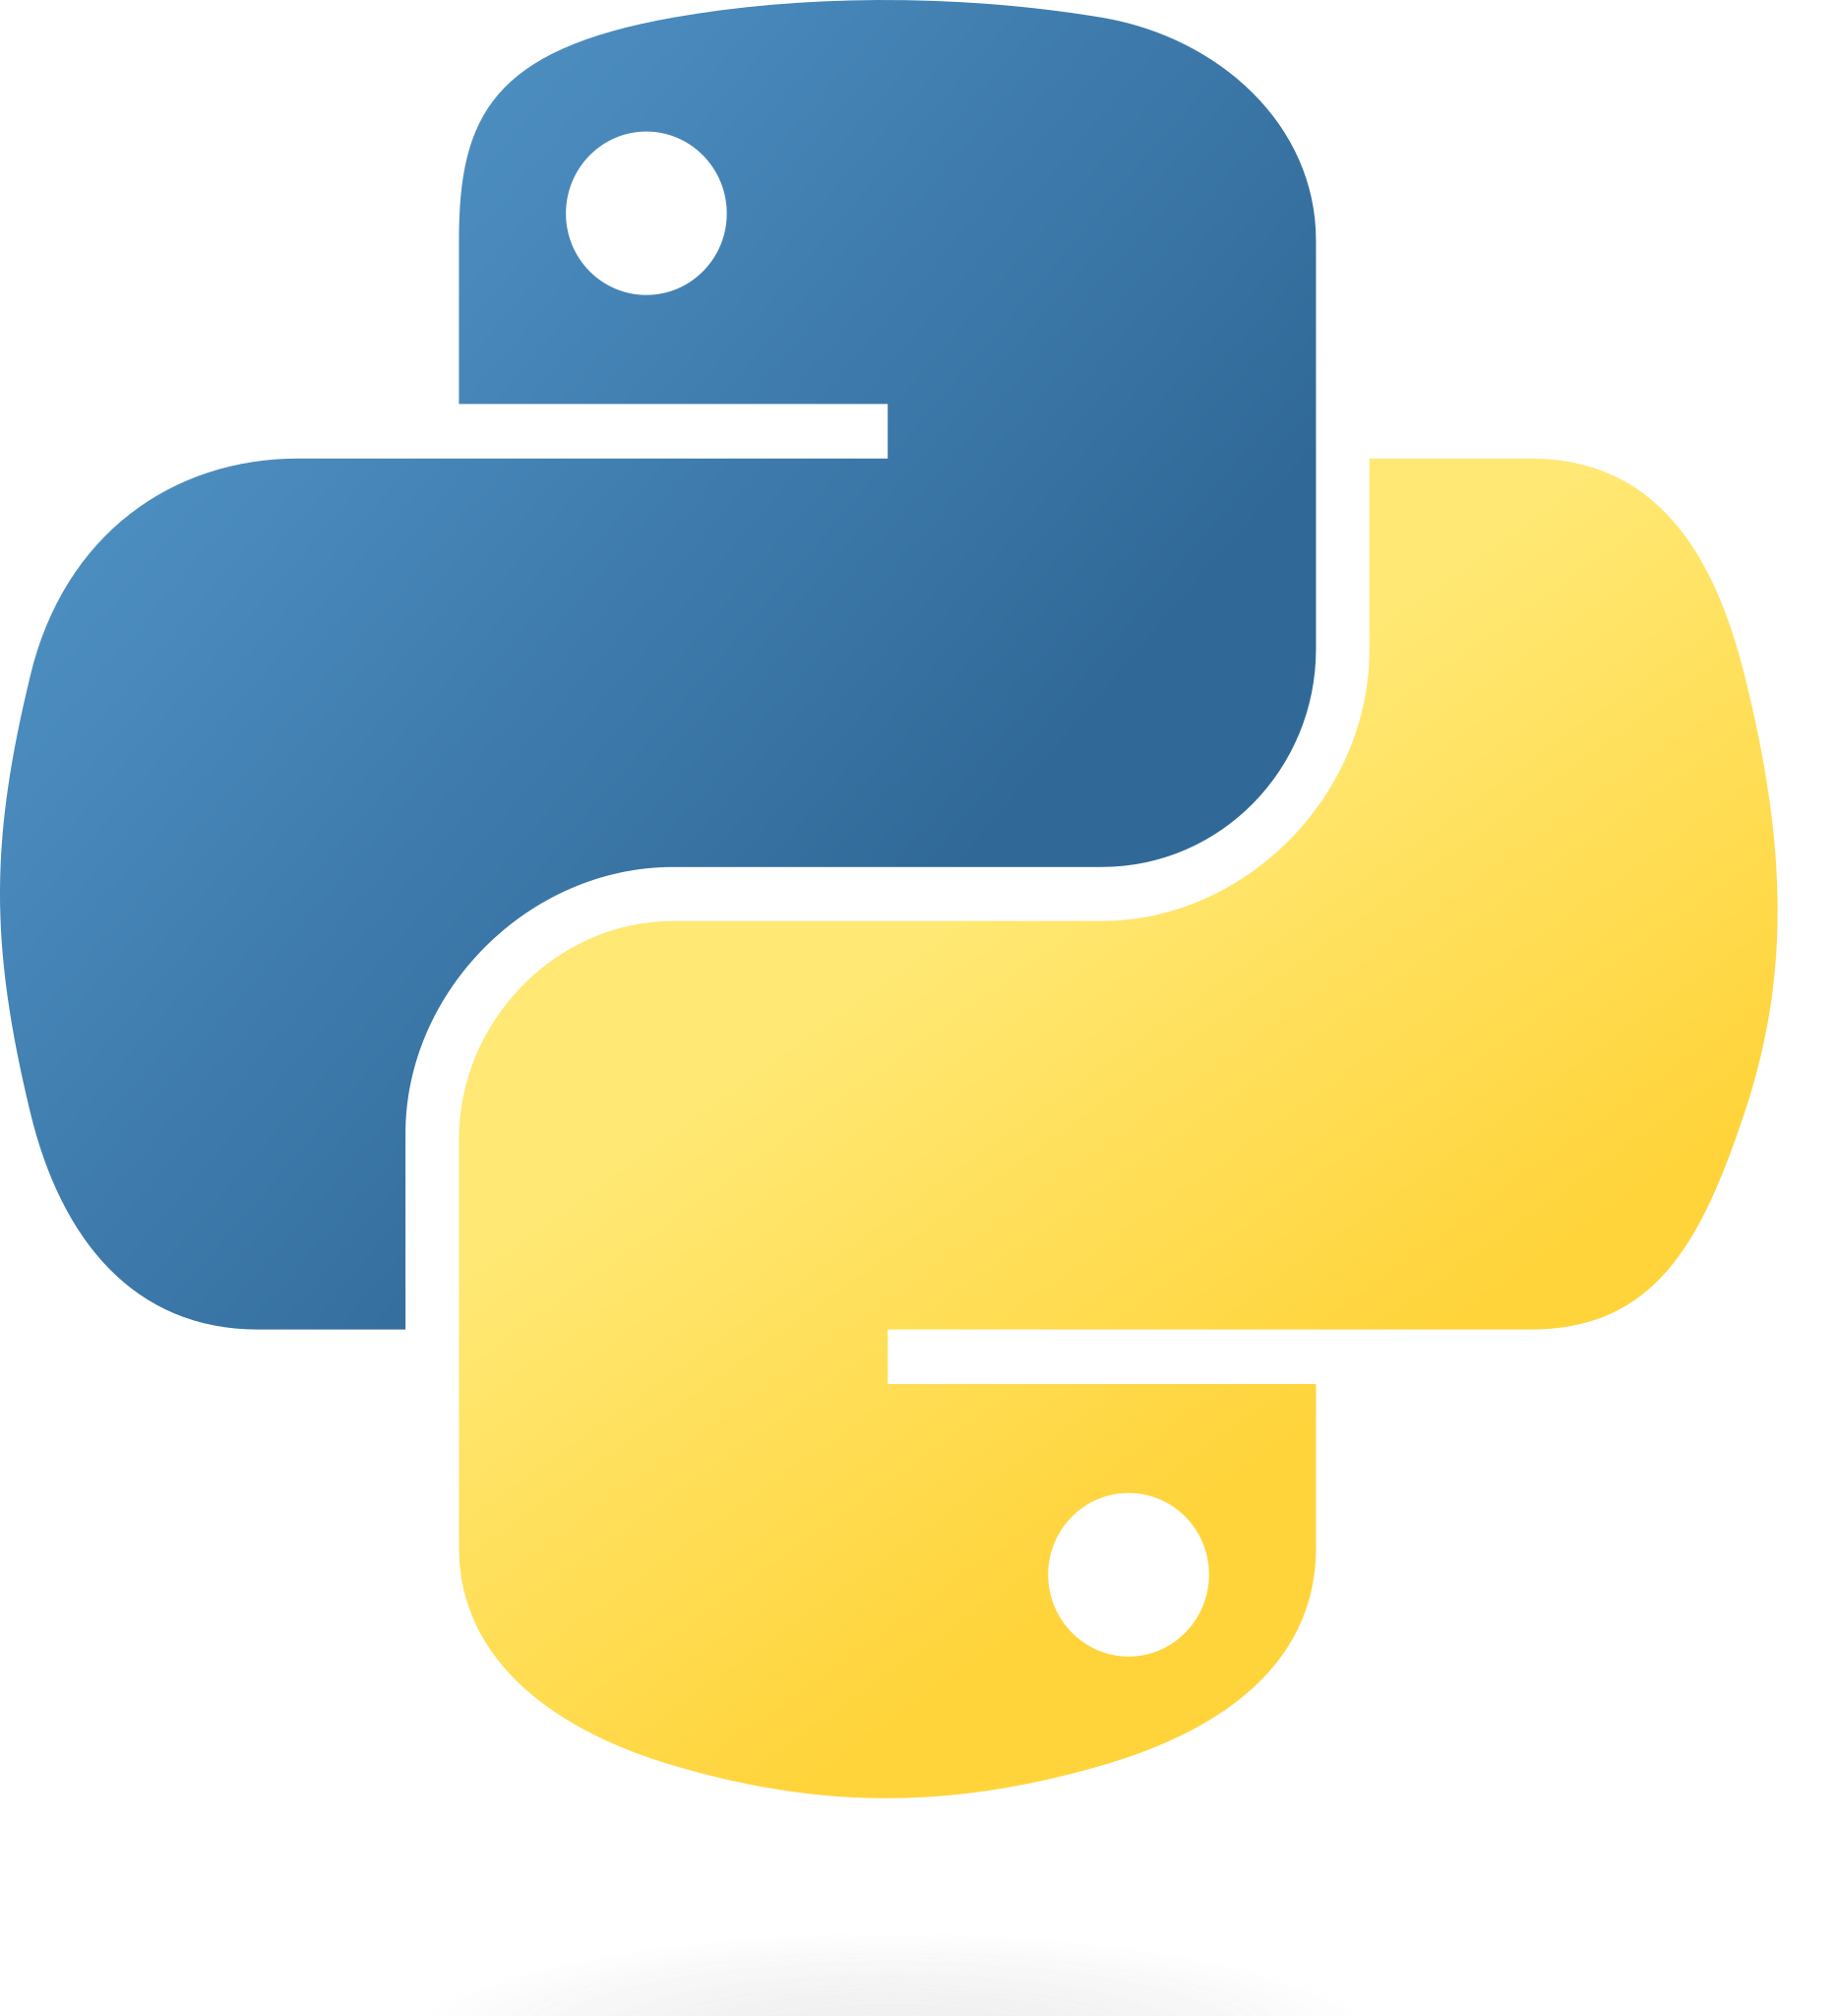
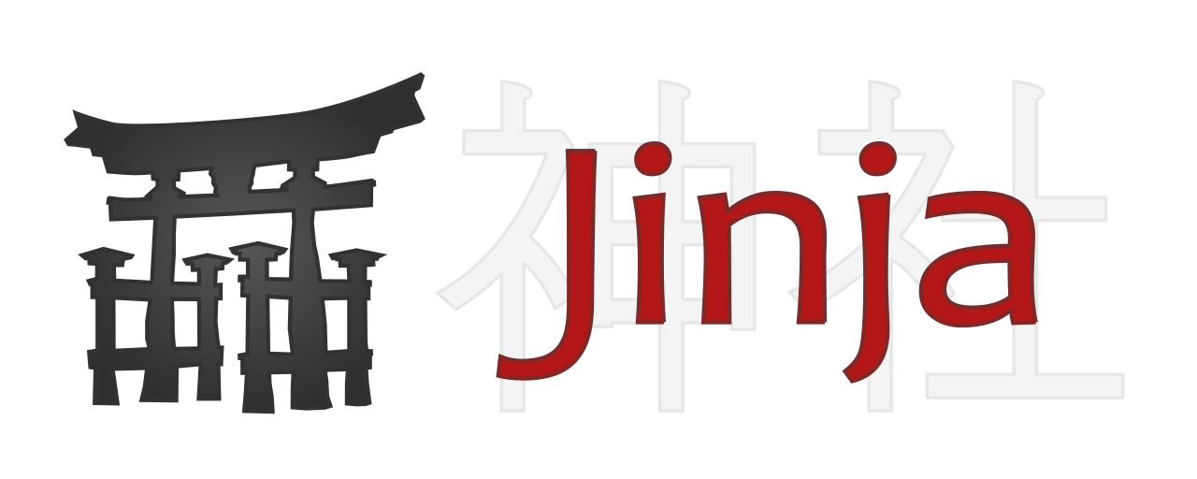
What is Python Flask
- Web Framework
Minimalistic
Modular
Extensible
- Python
- Jinja2 (dynamic content)

Slide 4
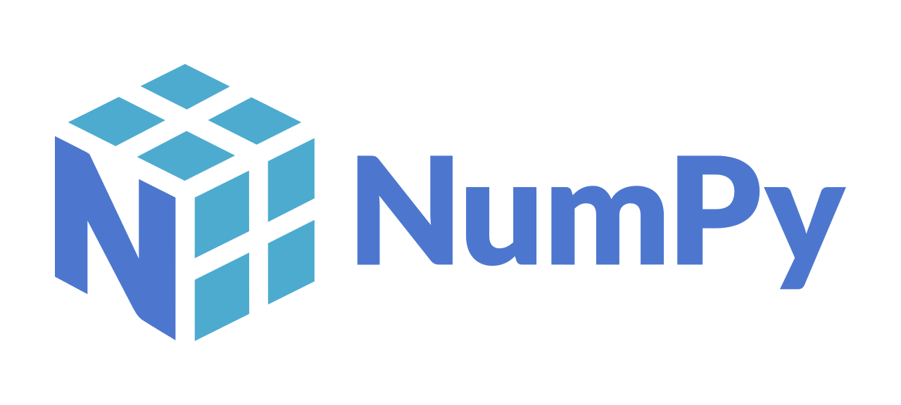
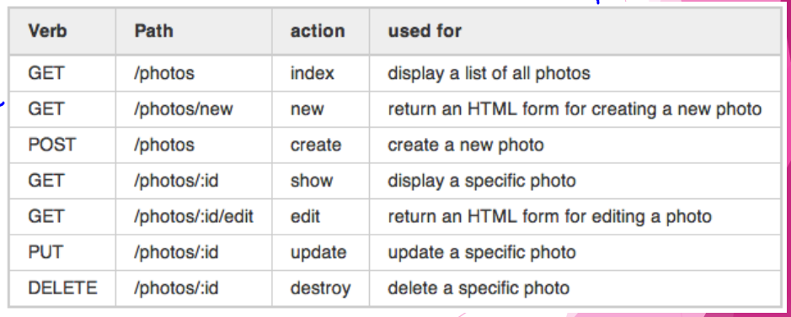
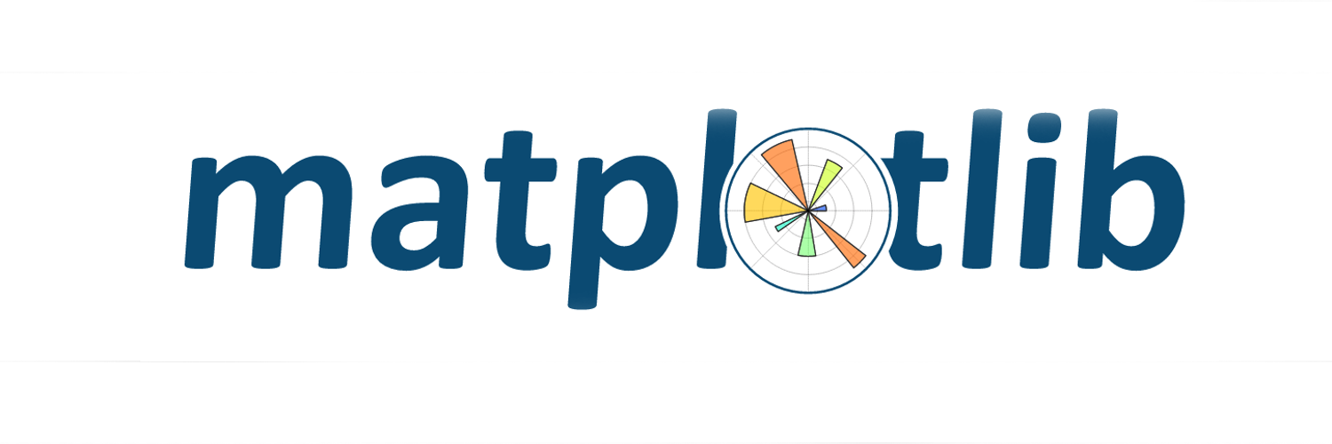
Uses of Python Flask
Libraries: numpy, matplot…
Manage HTTP Requests
Tools
Patterns

Slide 5
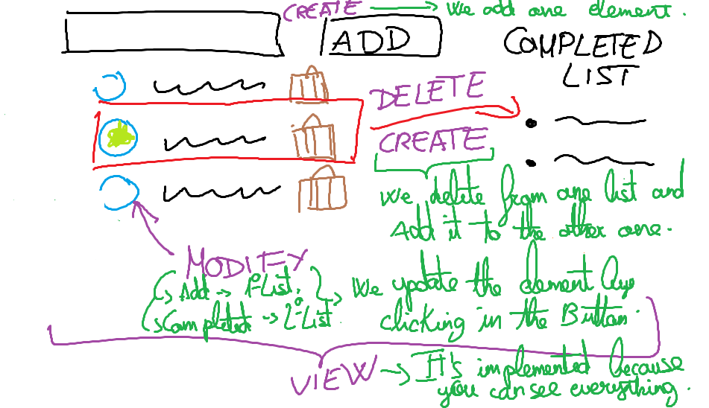
FIRST STEPS: My first Program. A Checklist

Slide 6
Any Questions?

